Slide 1
Future of Automation
“The Force Awakens”
Vladi Shlesman, CA Automic
Global Head of Presales

Slide 2
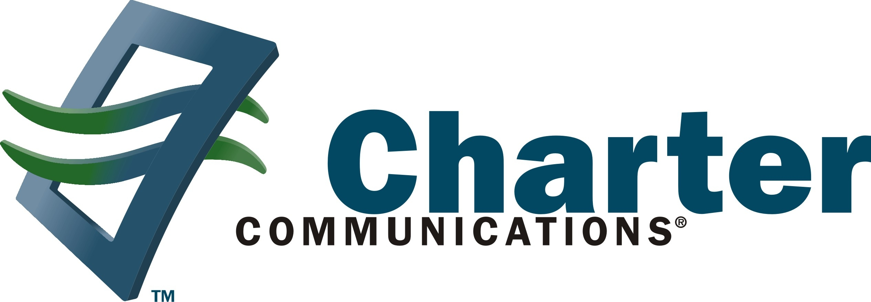
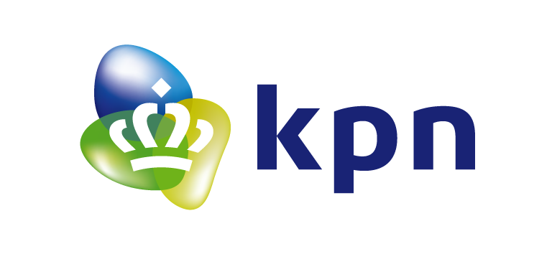


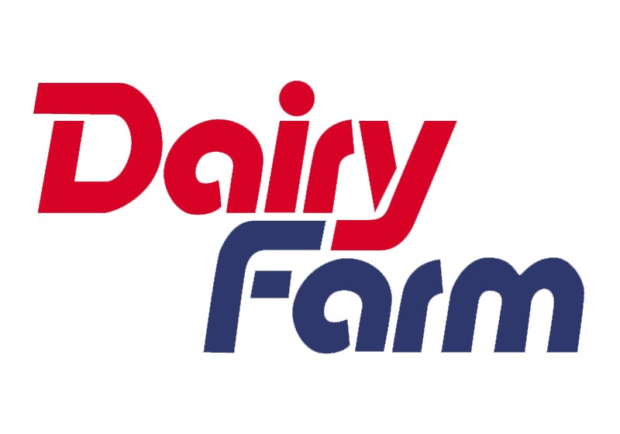
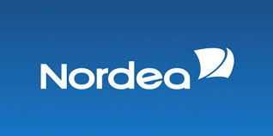
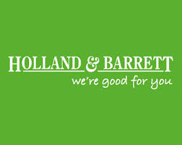




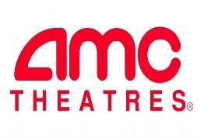

Automic Empowers our Clients’ Digital Transformation
adidas
Enabling the delivery of new and innovative services to the business
Agility & Speed
Built for Change
Bringing core apps closer to the digital business apps.
Notes:
UPS: Digital transformation driven by automation - spin-up new processes and services in hours instead of days .Improve speed and fidelity of business processes
Bet365: Rapid deployment of hundrds of updates a day to their productions systems.
TASC: From downtime windows to zero-downtime deployment to Amazon cloud leveraging Docker and Microservices.
Adidas: Stock replenishment programs to drive revenue
Netflix: Orchestrating data processes to drive the recommendation engine.
KPN: IT as-a-service to automate servicedesk requests ... AND ... Zero downtime upgrading of Siebel customer relationships ...
84:51: Rapid replacement of Redwood to drive data analytics, and deploying ARA
NHS Shared Business Services – finance closing of books (like Genworth).
Charter Comms: Deploying applications rapidly to take advantage of new business opportunities (eg: start of NFL season)
PG&E: Smart meter data transferral.
eBay: Orchestration of datawarehouse to drive faster decision making and business agility

Slide 3
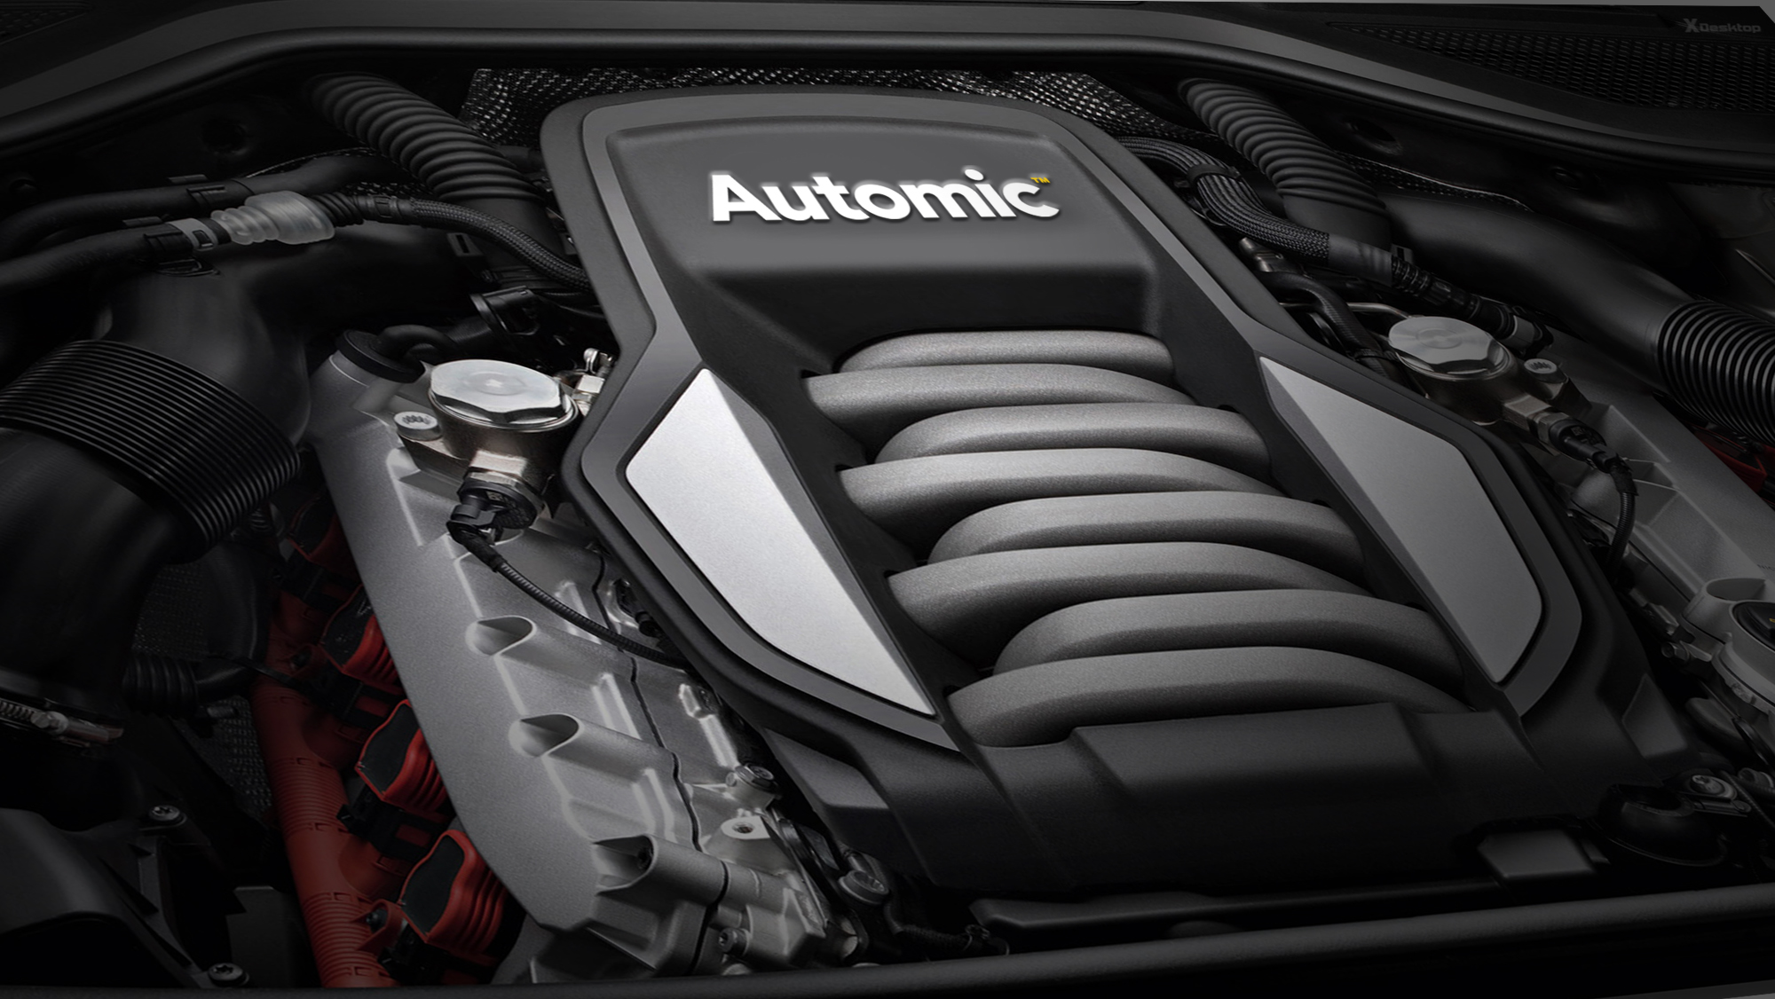
Automation is your transformation engine
Notes:
Automation is the engine of your IT racing car – got to be powerful, fast and reliable
Automation 2.0 from Automic helps you to translating ideas into fully automated processes and fast.
Driving new offerings - via orchestration and development.
Taking advantage of new technologies like Docker
Fast change in the automation to keep up with the business

Slide 4




The Playing Field has changed
Orchestrate Processes
Automate Workloads
Deploy Applications
Planet Earth
Provision Infrastructure
Notes:
Lets take a step back for one second.
The playing field has changed

Slide 5
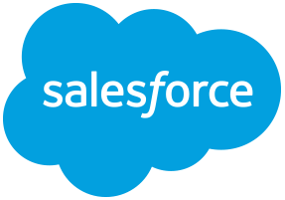


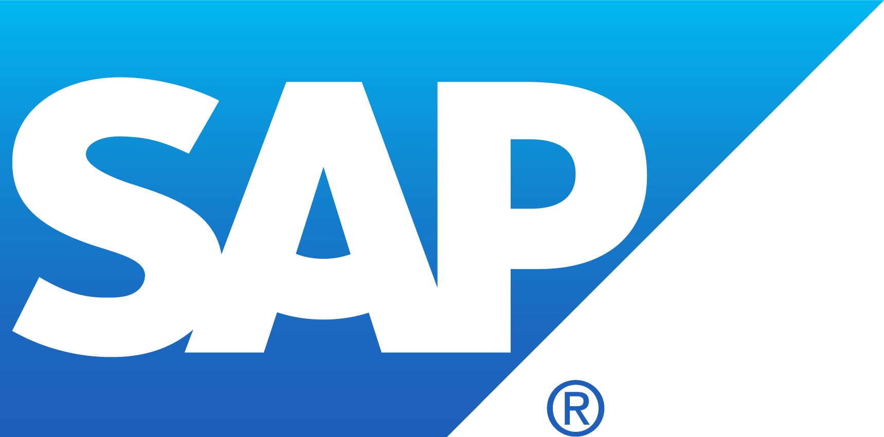

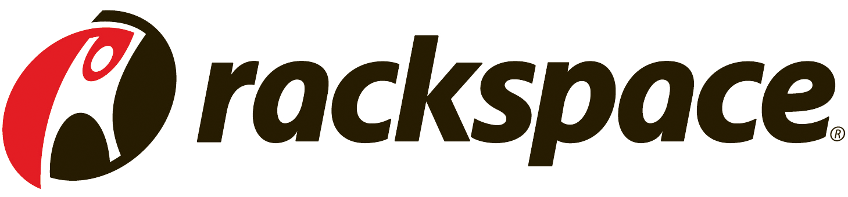


Planet Earth

Slide 6

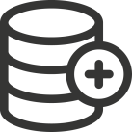
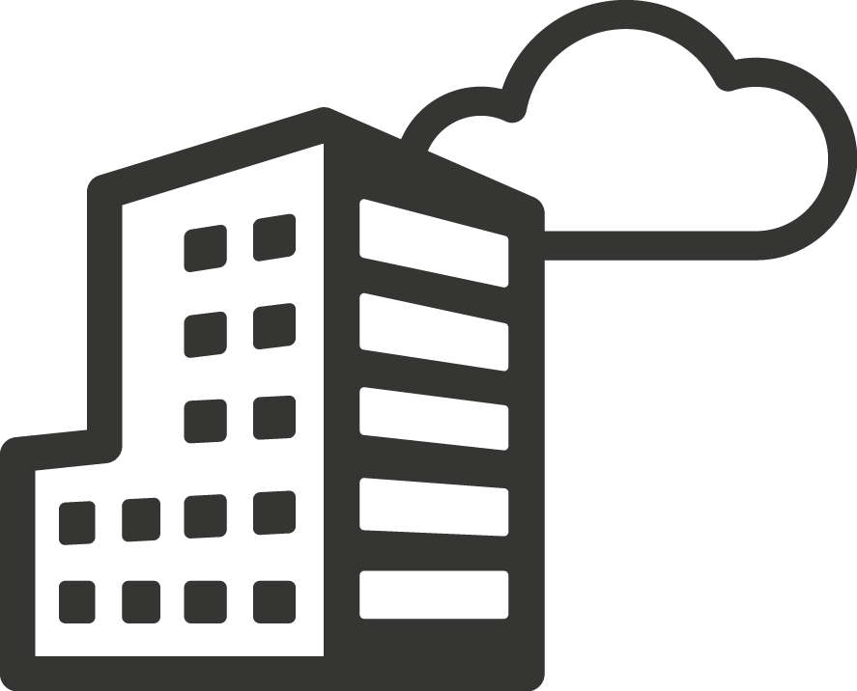
New Agility
across Core Apps
Empower DevOps
for new Web & Mobile Apps
Integrating Applications with the rest of the company processes, including building, deploying & updating
Release, provisioning, and on-going orchestration of customer-facing web and mobile services
Simplifying Business Process
Driving
Intelligent Analytics
Customer on-boarding, Financial close,
Retail optimisation
Automating & Orchestrating ETL, MFT, Datawarehousing, Big Data, Analytics
Enabling
IT-as-a-Service
Managing the Hybrid Cloud
Fulfilment of service management requests and procedures
Planet Earth
Provisioning, orchestration and automation across and within hybrid cloud environments

Slide 7
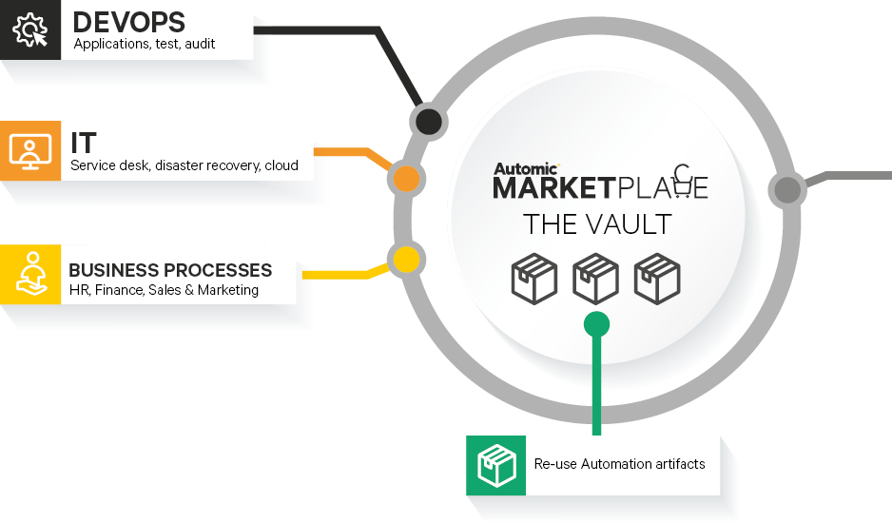
Automation Center of Excellence
Planet Earth

Slide 8
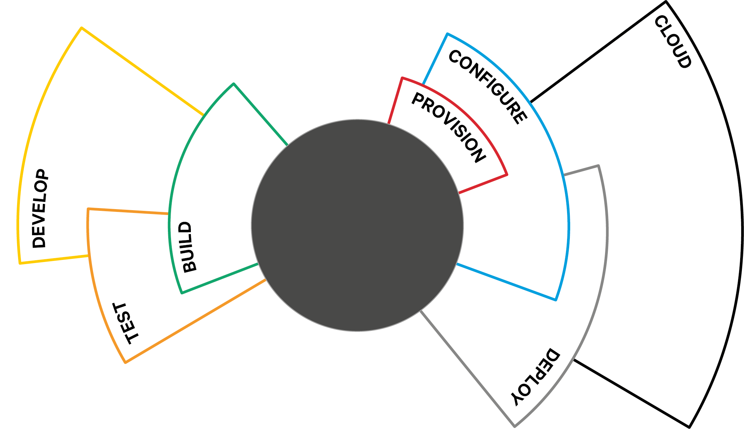
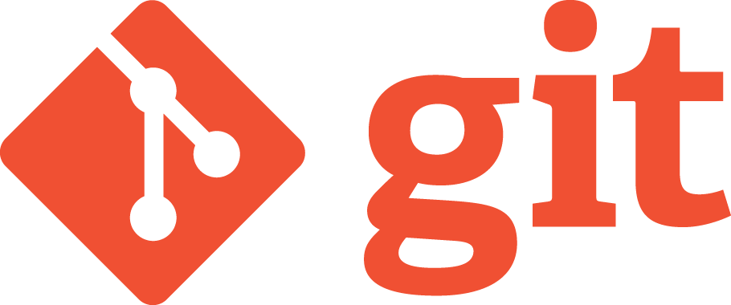
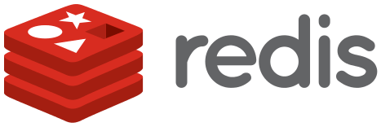

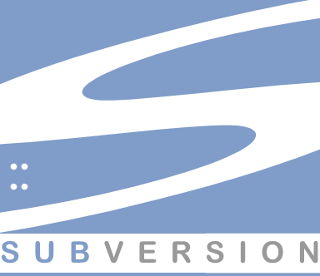
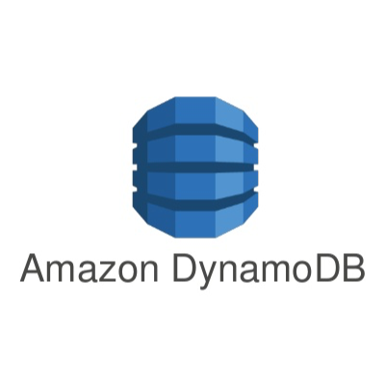
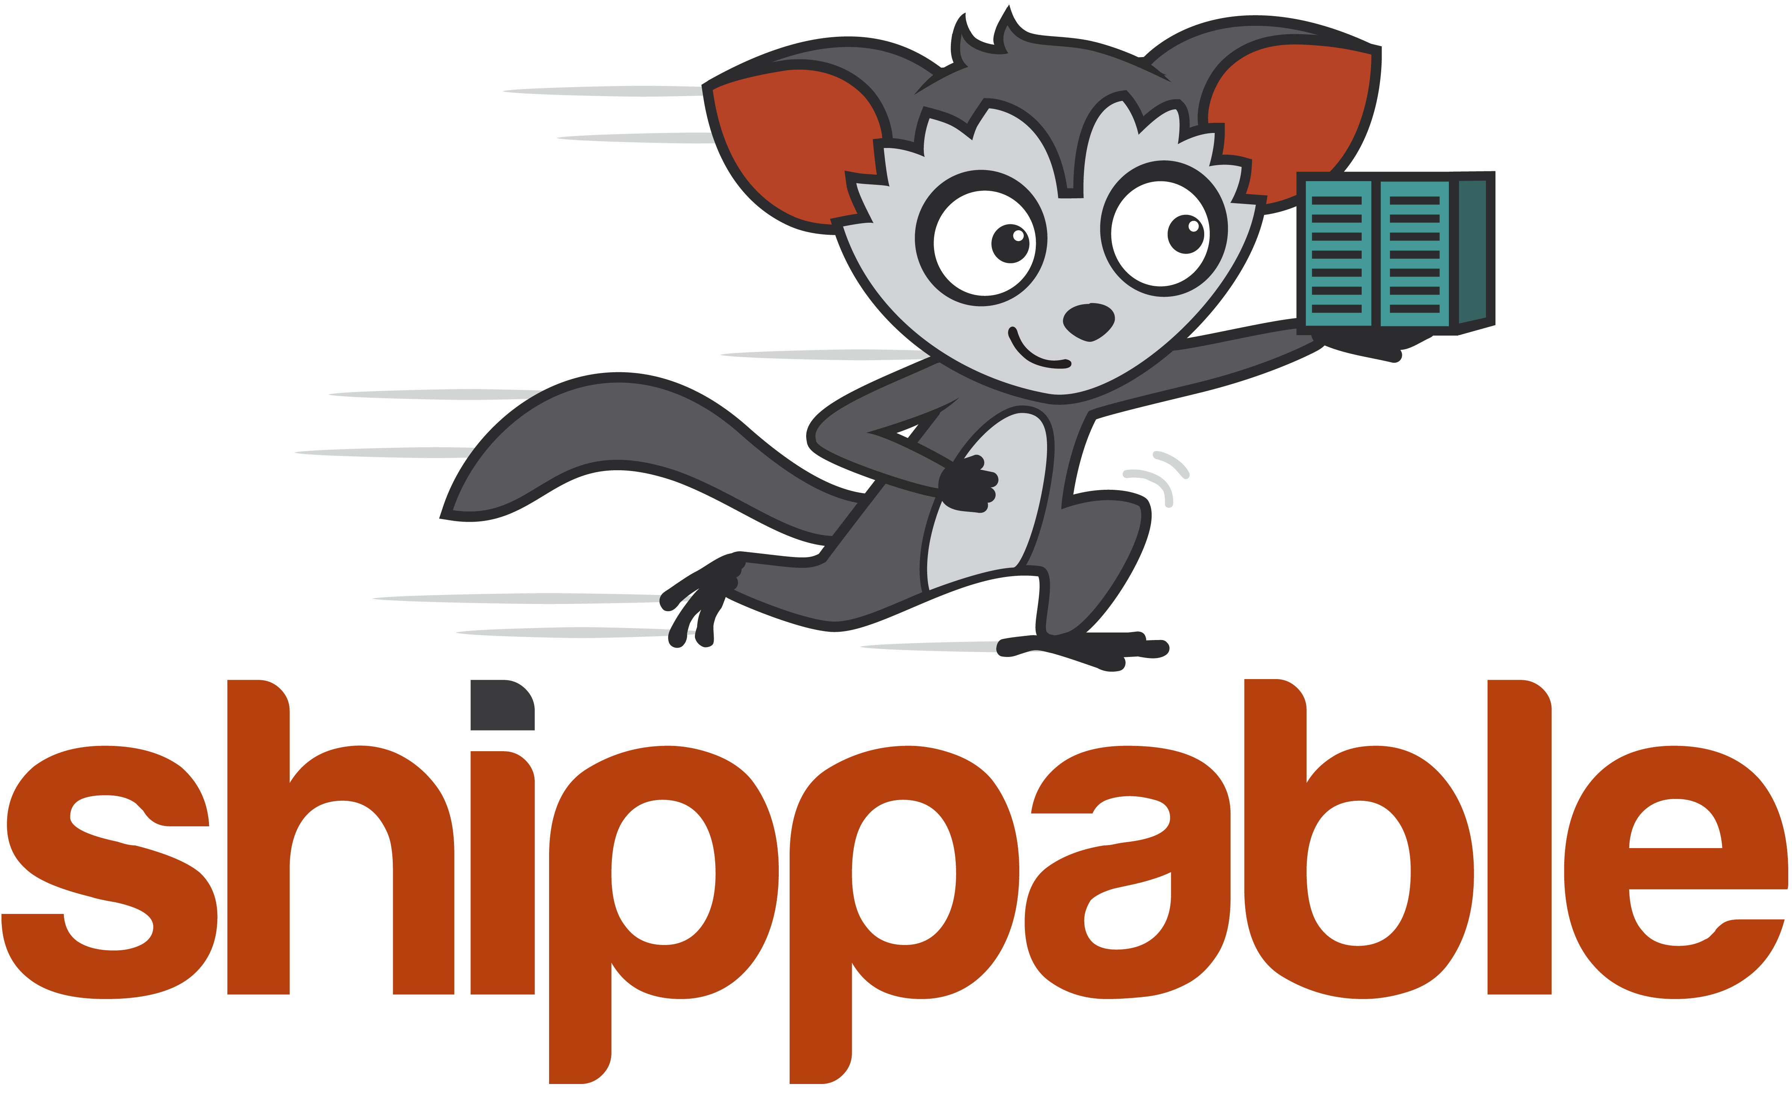
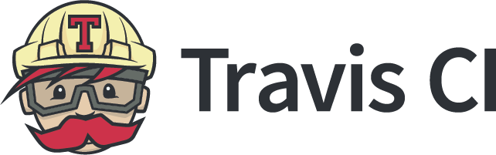
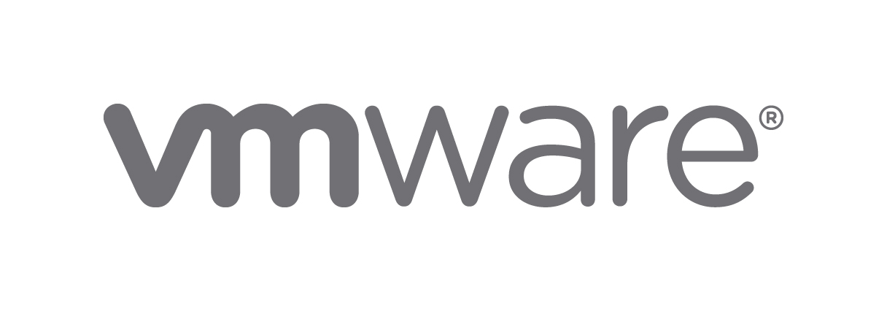
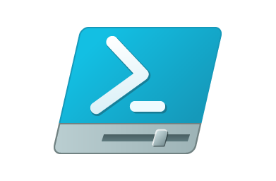
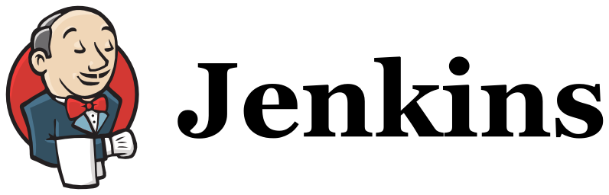

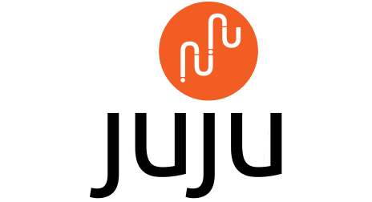

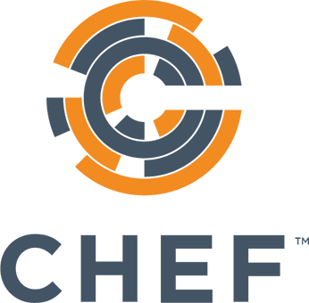
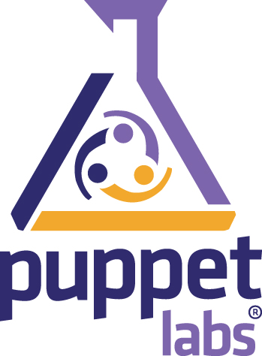
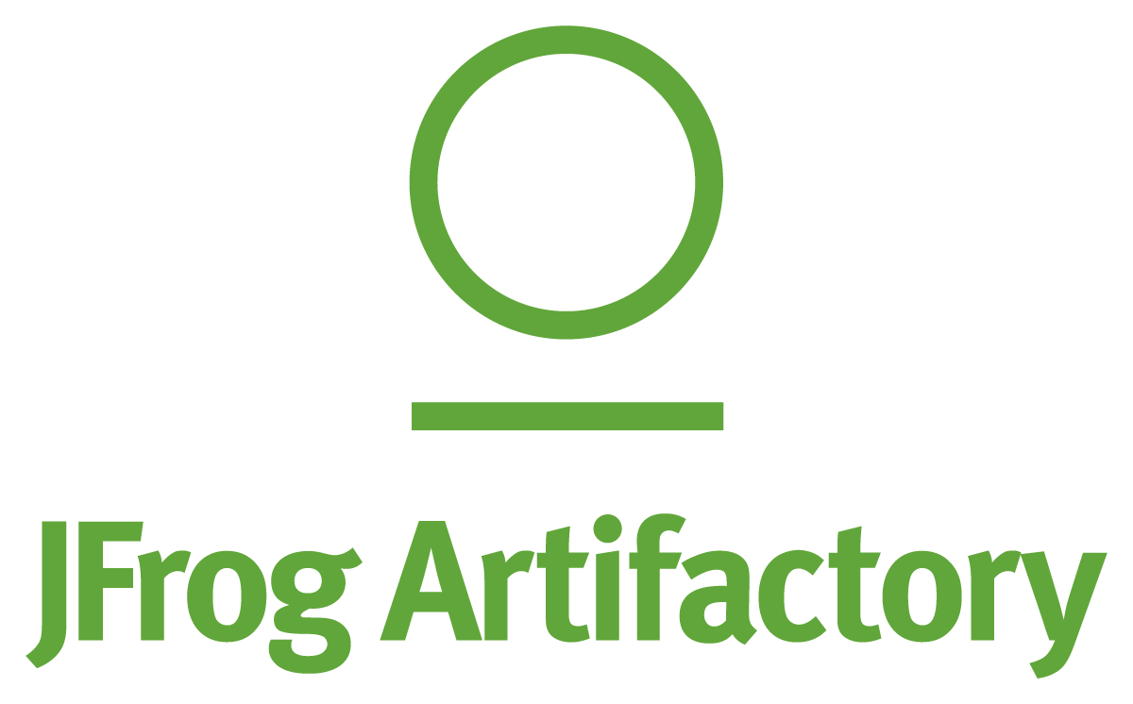
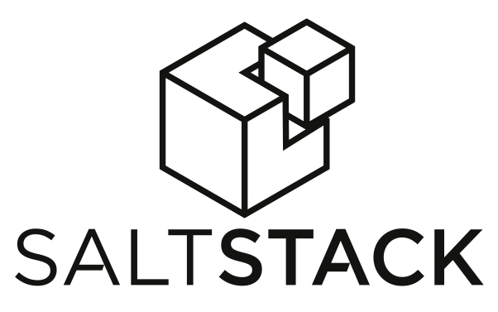
How Automic Works Automating within and Orchestrating across the DevOps toolchain
Model
Automate
Orchestrate
DevOps

Slide 9

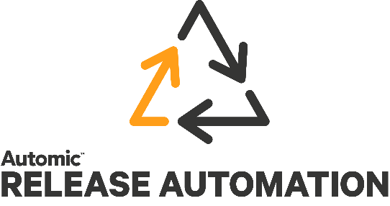
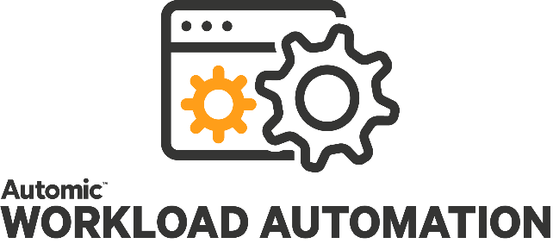
V12
V12
V12
Business
Developers
IT Ops
A Unique “SaaS-ready” Automation Platform
Open
Scalable
Unified
Multi-Tenant
Object Oriented
Customizable
Easy-to-use
Proven
Zero Downtime Upgrades
Audit Ready
Notes:
The product. So I hope you noticed that I put the product slide last. It should be last. If this is ever the first slide we put in front of a customer, we are missing the point. The value we derive is based on the outcomes we can achieve for a customer and the stories tell this. The product is simply a means to an end. But of course, sometimes you have to go there. And these products are best in class, built on a common platform with some capabilities that are unique. 2,000 on this platform. Multi-tenant, cloud enabled already. Customers can run us on prem or in a cloud and several customers do this. Netflix runs us in an AWS instance as does Cap gemini taking advantage of the multi-tenant capability to offer Automation as a Service. And unique in the workload industry, zero downtime upgrades.
So you have

Slide 10
Automation: Yesterday
(1) Infrastructure
(2) Apps
(3) Business Process
ASO
ARA
AWA
One Automation Platform

Slide 11
Automation: Today
(1) Infrastructure
(1) Full Stack Apps
(2) Business Process
ASO
ASOARA
AWA
One Automation Platform

Slide 12
Automation: Tomorrow
(2) Full Stack Apps
(1) Business Process
ASOARA
AWA
One Automation Platform

Slide 13
Automation: Tomorrow
(1) Decision
(2) Business Process
(3) Full Stack Apps
Decision Engine
AWA
ASOARA
One Automation Platform

Slide 14
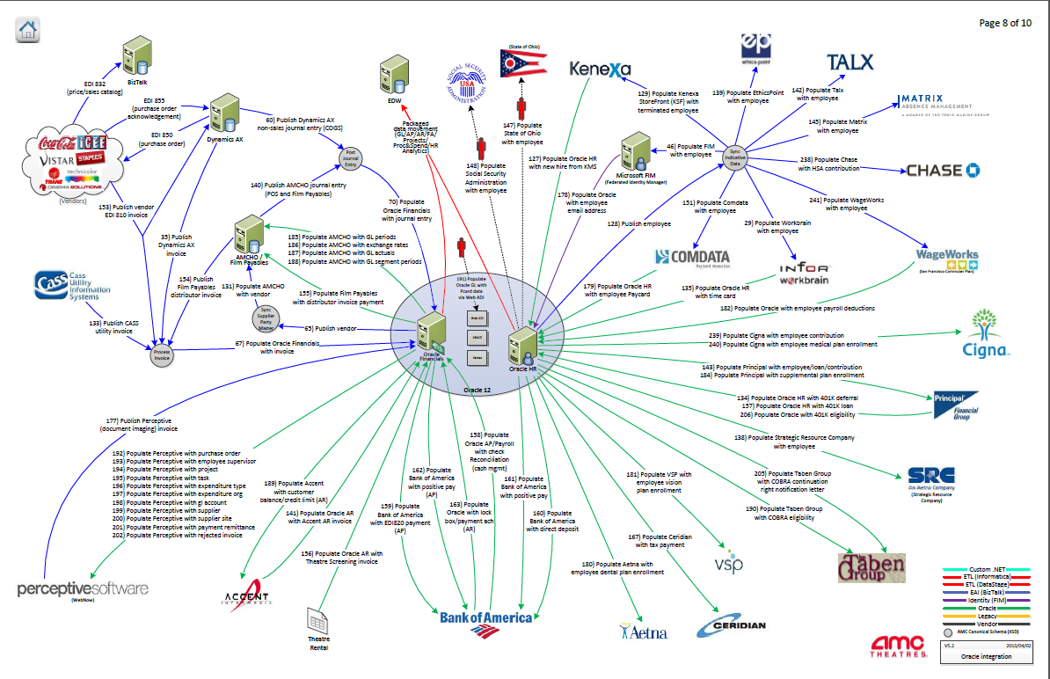
Complexity Behind the Screen

Slide 15

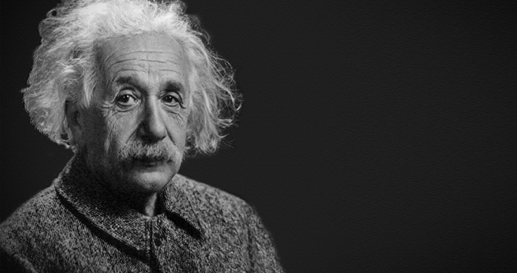
“
“
The True sign of intelligence is not knowledge but imagination
Albert Einsten
Notes:
Agility, Automation, Insights and Security are the critical components of what we call the modern software factory, your blueprint for success.
A modern software factory is agile, built to change and adapt to whatever the market throws at you. Agile teams work collaboratively and iteratively to bring new ideas to market, producing the outcomes that matter to customers.
Automation is essential, the key to continuously developing, testing and delivering app experiences your customers will love. Automation saves time, money, hassle and reduces errors, so you have more cycles to pursue innovation that creates new value.
Insights are the “competitive fuel” that keeps your factory moving in the right direction. Your software can be designed to give you a constant stream of feedback that smart analytics can turn into insights, to make sure the experiences you deliver keep getting better.
Strong security is designed into your apps from the beginning, protecting your most valuable assets and building users trust, without getting in the way.
A modern software factory excels at all four of these principles, for agility, automation, insights and security at scale—which means that you can consistently deliver the trust, value, speed and reliability that your customers demand.
Your modern software factory ensures that your company is ‘built to change,’ and adapt successfully to the increasing turbulence caused by the rapidly accelerating pace of change.

Slide 16



Intelligent Automation Roadmap
Artificial Intelligence &
Machine Learning
Decision Optimization via
AI - Machine Learning
Application awareness
Business policies drive processes, not infrastructure
Orchestrates on-premises and cloud applications
Drive Business Value
Algorithmic/Heuristic driven
Decision Automation
Based on AI platform
Future technology
Business Rules & Policies
Based on AI platform
Intelligence
Cost and resource-aware routing of processes
Proactive process control and optimisation
Pervasive Automation
Hybrid/Multi-Cloud / Data Center Orchestration
Hybrid/Multi-Cloud / Data Center Integrations
Intelligent Automation
Data-driven
Decision Automation
Based on AI platform
Scalability
Enables dynamic provisioning for applications
Runs processes across hybrid environments
Open Data Fabric
Service Orchestration
Ease of use
Pervasive Automation
delivered over the web
Simple, intuitive and web-based user interface
Release Automation
Workload Automation

Slide 17
Dimensions of Intelligent Automation
Workflow Automation
State transitions
Dependency management
Configuration Management
On demand infrastructure
End-point management
Resource Management
Inventory
Reservation & Scheduling
Remediation
Decision (Business) Automation
SLA adherence & management
Business policies and rules
Budget and cost management
License management

Slide 18
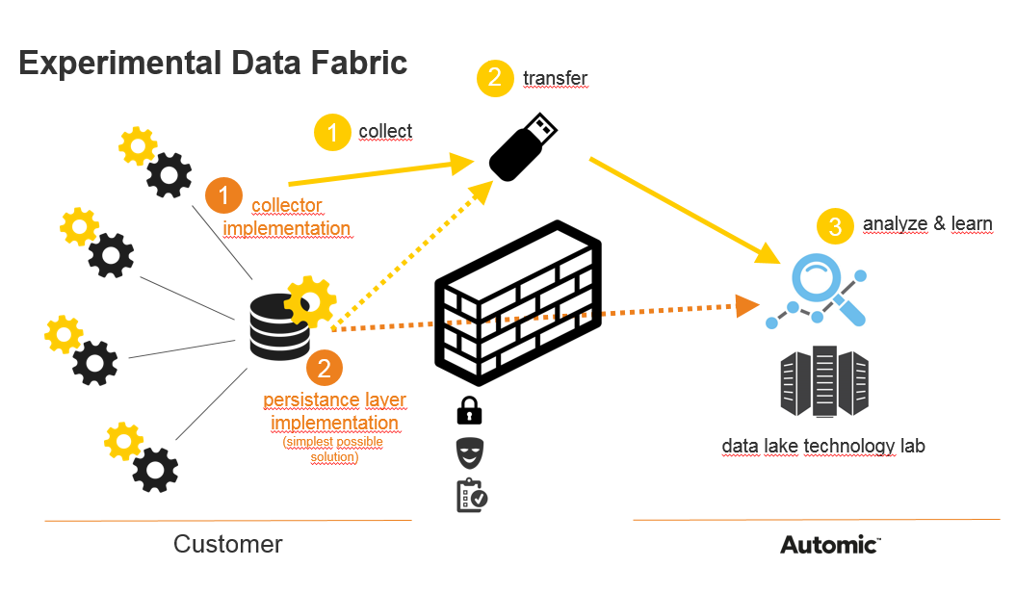


Business
Developers
IT Ops
A Unique “SaaS-ready” Automation Platform
Smart Data Platform
Automation Data Fabric
Automation Data Lake
Notes:
The product. So I hope you noticed that I put the product slide last. It should be last. If this is ever the first slide we put in front of a customer, we are missing the point. The value we derive is based on the outcomes we can achieve for a customer and the stories tell this. The product is simply a means to an end. But of course, sometimes you have to go there. And these products are best in class, built on a common platform with some capabilities that are unique. 2,000 on this platform. Multi-tenant, cloud enabled already. Customers can run us on prem or in a cloud and several customers do this. Netflix runs us in an AWS instance as does Cap gemini taking advantage of the multi-tenant capability to offer Automation as a Service. And unique in the workload industry, zero downtime upgrades.
So you have

Slide 19
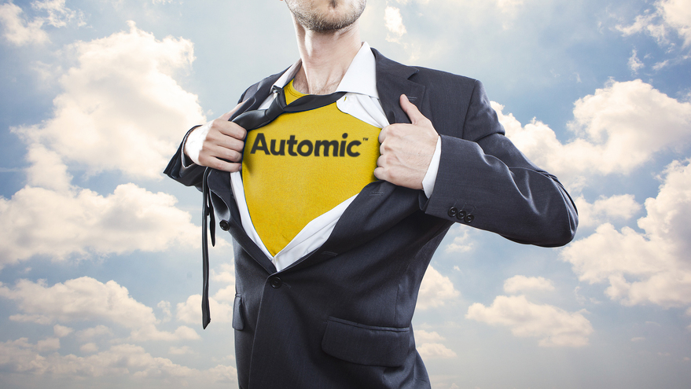
Your Call to Action
Become the Automation Champion to your Business
Notes:
We will be announcing our Automation Hero’s on Thursday evening. These are great examples of using automation in amazingly innovation ways. I’d like to hear more from you all about how you are using automation,.
So ... Please send us your story and we will send you a present.

Slide 20

Embrace change and creativity
The Future of Automation
Notes:
Talking about keeping the lights on.. Make sure those are the right types of lights ..
Constant improvement and progress = happiness
Automation is a bigger gun to fight daily battles
Don’t sweat the little stuff - killing routine tasks is empowering creativity

Slide 21
Smart Data Platform → Intelligent Data Platform
Delivered as a service.
Enterprise data from a single datacenter / cloud
Enterprise data from multiple datacenters / clouds
Multiple Enterprise’s data aggregated at large scale
Consider what Google, Facebook, Netflix, et al do with their aggregated data…
Advanced Future Intelligent Automation Services:
Automation “Recomendation” Engine
Enterprise Automation Ranking Service
Driving Remediation/Optimization through Industry Best Practices derived from machine learning across the automation population.
Notes:
The product. So I hope you noticed that I put the product slide last. It should be last. If this is ever the first slide we put in front of a customer, we are missing the point. The value we derive is based on the outcomes we can achieve for a customer and the stories tell this. The product is simply a means to an end. But of course, sometimes you have to go there. And these products are best in class, built on a common platform with some capabilities that are unique. 2,000 on this platform. Multi-tenant, cloud enabled already. Customers can run us on prem or in a cloud and several customers do this. Netflix runs us in an AWS instance as does Cap gemini taking advantage of the multi-tenant capability to offer Automation as a Service. And unique in the workload industry, zero downtime upgrades.
So you have

